Slide 1
Features
Project Title: Meetup App
Requirements Engineering Project

Slide 2
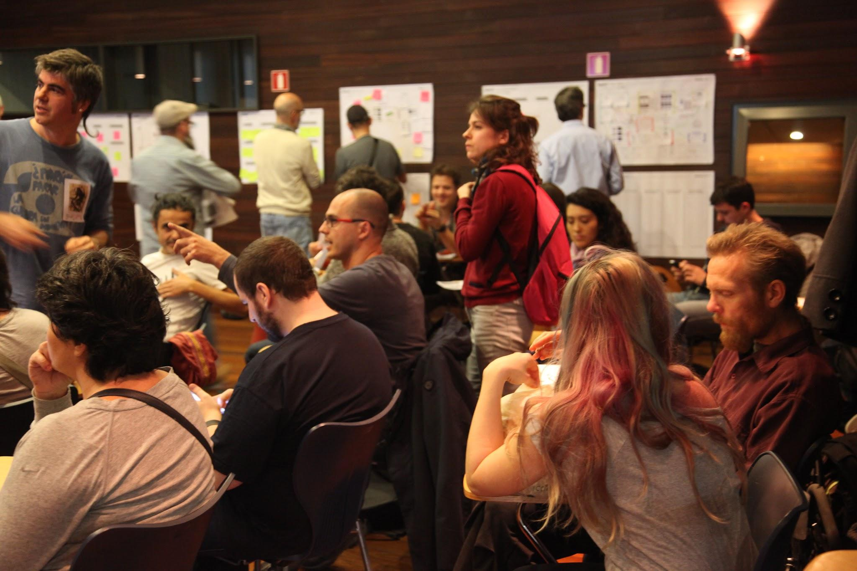
What the user expects - ‘Must be’ feature
Benefit
User finds a Meetup Event
Select Date
Select Location
Select Meetups near you
Select popular Meetups
Filter Meetups as per location, interests / category or per dates
See results (Meetups) of all the selections and/or filters
User can join any of the Meetups from the results list
Features

Slide 3
Ease of use
Benefit
User joins a Meetup Event
User can chat with existing participants
User can provide suggestions to the host
User can be notified about latest event updates
User can share the event on social media platform
User can hide the event from his profile
User can upload photos of the event
Features

Slide 4
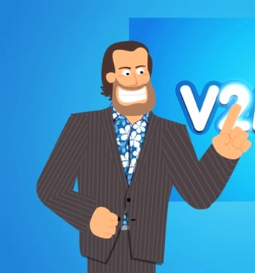
Ease of use - ‘One Dimensional’ feature
Benefit
User creates a Meetup Event (as a Host)
User adds category he/she/they wants to create the event
Within the category, user enters name of the event
User mentions short description of the event
User selects Venue
User selects Date of the event
User selects Time of the event
User selects the limit on the number of people (optional)
Features

Slide 5

Get better as the competition
Benefit
User as a participant
User has variety of options in meetups
90% of the events are free
Search algorithm is superior
All event are validated by the meetup app
Trustworthy events
Only verified users are allowed to host an event
Features

Slide 6
Get better as the competition
Benefit
User as a participant and a Host
Target users as per their previous interests
Notify RSVP users
Integrate with digital calendars
Better and simple UI and service
Interest-based Matching
Group Formation
Organizer Tools
In-app Ticketing and Payment
Gamification Elements
Features

Slide 7

Become the golden standard
Benefit
AI, AR/VR and LLM
User can chat with the chatbot
AI analyses the user behaviour and notifies relevant events
User can create avatar of themself
User can attend the event through AR/VR technology
Features

